Slide 1

Disaster Management Dashboard Created with IBM Cognos Analytics
TEAM MEMBERS 221191101122 – SANJAI B 221191101141 – UDAIYANETHI S 221191101146 – vedha narayanan b
Dashboard Link: DISASTER MANAGEMENT

Slide 2
Crisis Management and Response Dashboar
Build a crisis management and response dashboard for organizations to monitor and respond to emergency situations such as natural disasters, cybersecurity threats, or public health crises. Integrate data from emergency response teams, social media feeds, and news sources to provide real-time situational awareness and decision support. Use Cognos BI to visualize critical information such as incident locations, resource allocations, and response timelines to facilitate effective crisis management and coordination.

Slide 3

Introduction
Objective:Visualize and analyze global disaster data to aid decision-making.Scope:Covers various disaster types worldwide.
Key metrics: total affected, deaths, economic impacts.
Tools & Process:Used IBM Cognos Analytics.Collected data from Kaggle, cleaned, and created interactive visualizations.

Slide 4

Data Collection
Key Points:Source: The dataset was sourced from Kaggle.
Format: The dataset was in CSV format.
Content: Included disaster types, affected populations, economic impacts, geographical locations, and timelines.

Slide 5

Data Analysis
Initial Review: Conducted an initial review to understand the structure and content of the data.
Key Variables Identified:Disaster types
Total affected individuals
Total deaths
Economic impacts (reconstruction costs, insured damages, aid contributions)
Geographical locations
Data Preparation:Cleaned data using IBM Cognos Data Module tool.
Corrected inconsistencies, fixed missing values, and addressed formatting errors.Ensured data accuracy for reliable insights.

Slide 6

Dashboard Design
Template Used: Started with a blank template in IBM Cognos Analytics.
Resource Added: Imported the cleaned data module into the dashboard environment.
Planning:Identified key metrics and visualizations for valuable insights.Designed a user-friendly and intuitive layout.

Slide 7

Implementing Visualizations
The dashboard utilizes various visualizations to present disaster data in an insightful way.
Visualizations Used:
Map Visualization
Radial Chart
Dual Line Chart
line and Column Chart
Table

Slide 8

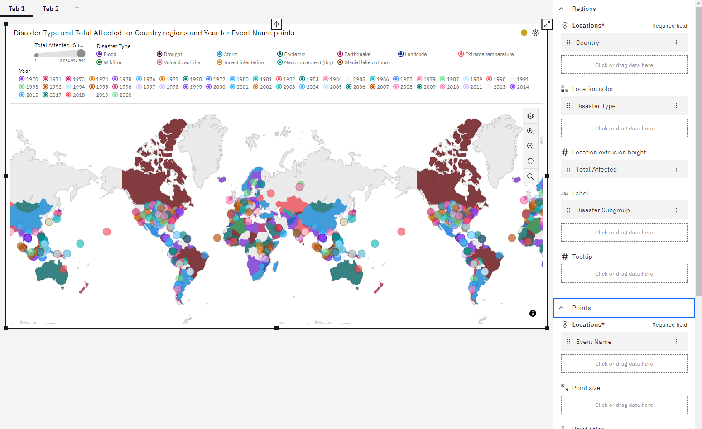
Map Visualization
Purpose: Show Disaster Type and Total Affected for Country regions and Year.
Details: Interactive map displaying disaster events by location and time, with color coding and size variations.

Slide 9

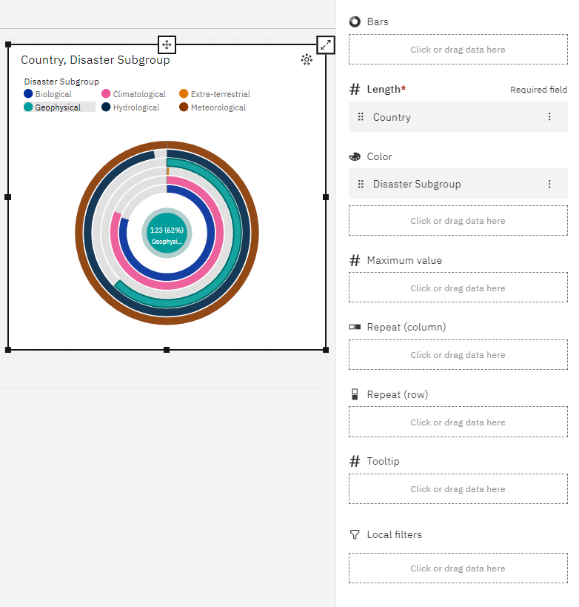
Radial Chart
Purpose: Show Country and Disaster Subgroup.
Details: Circular chart representing the distribution of different disaster subgroups across countries.

Slide 10
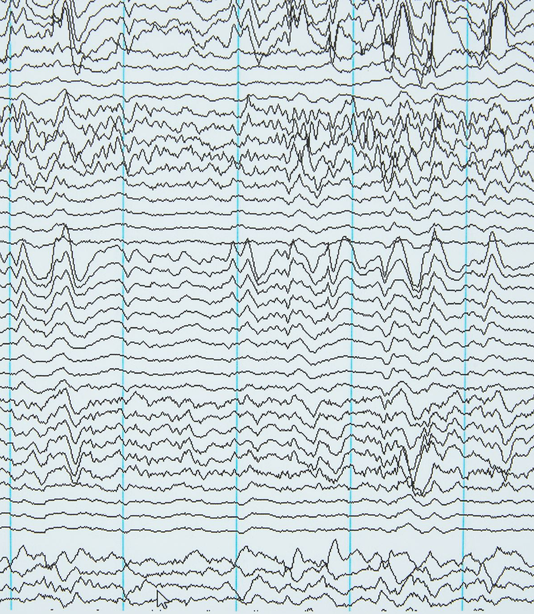
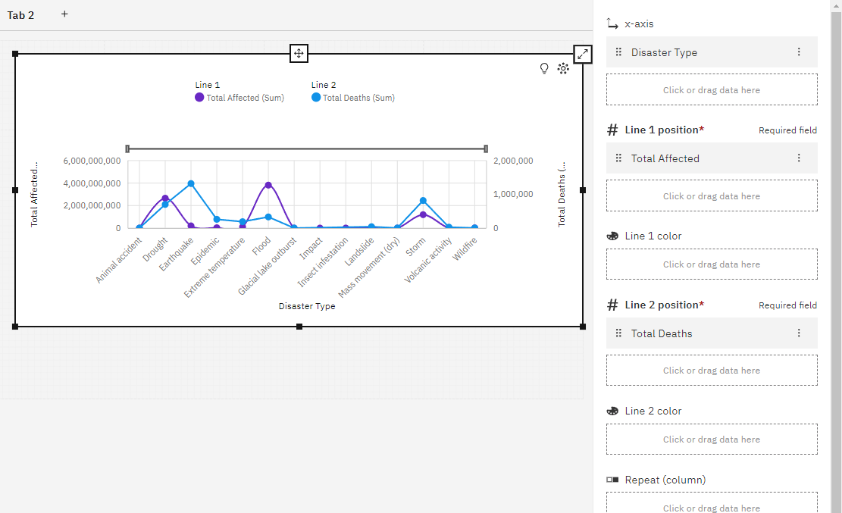
Dual Line Chart
Purpose: Show Total Affected and Total Deaths by Disaster Type.
Details: Two line graphs showing trends in affected populations and fatalities over time, by disaster type.

Slide 11

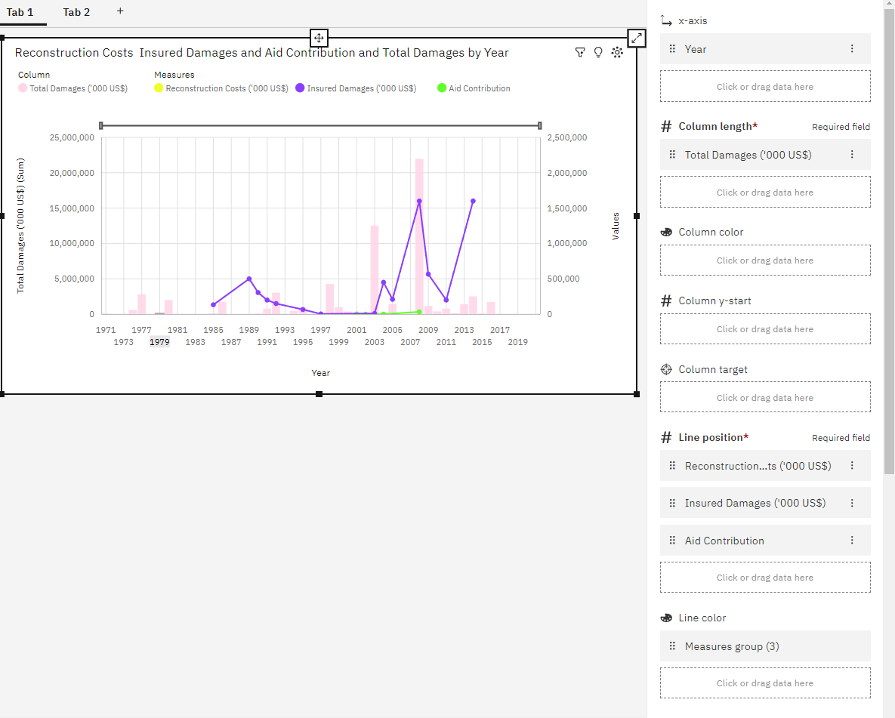
Line and Column Chart
Purpose: Show Reconstruction Costs, Insured Damages, Aid Contribution, and Total Damages by Year.
Details: Bar chart combined with line graphs illustrating economic impacts and aid distribution over the years.

Slide 12
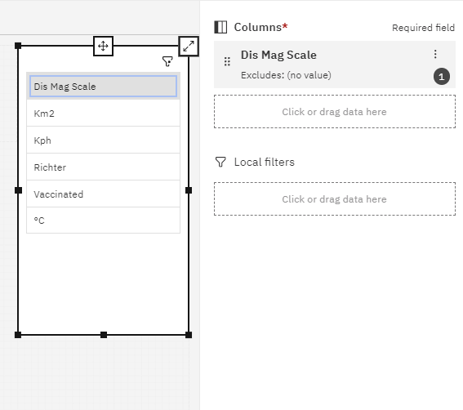
Table
Purpose: Show Disaster Magnitude Scale (Dis Mag Scale).
Details: Tabular representation of disaster magnitudes for easy comparison and analysis.

Slide 13

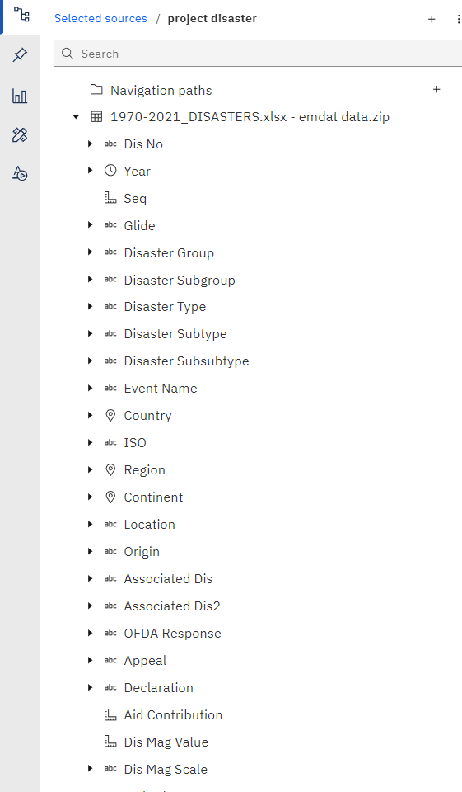
Insights and Analysis
Key Findings:
Identified regions most affected by specific disaster types.
Observed trends in the frequency and impact of different disasters over time.
Analyzed economic impacts and aid contributions, highlighting areas needing more support.
Implications:
Inform disaster management strategies and policies.Aid in resource allocation and planning for future responses.

Slide 14
Future Enhancements
Potential Improvements:
Integrating real-time data for up-to-date insights.Expanding the dataset to include more variables and sources.
Additional Features:
Adding interactive elements like predictive analytics and scenario simulations.Enhancing user customization options for personalized analysis.
Continuous Improvement:
Regularly updating the dashboard based on user feedback and emerging needs.

Slide 15
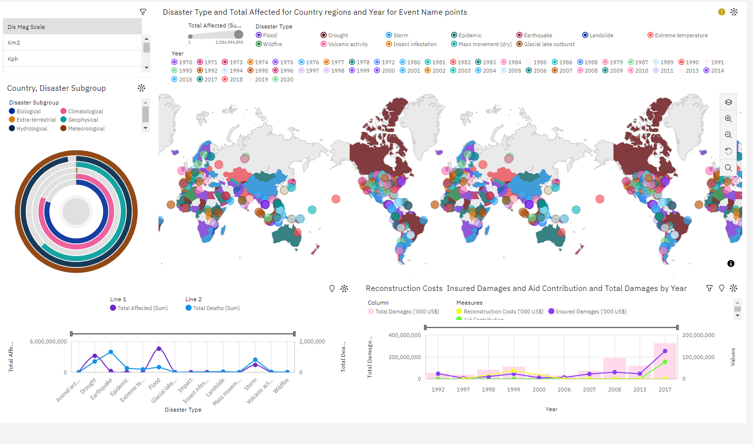
Conclusion
Summary:Created a comprehensive dashboard to visualize and analyze disaster data using IBM Cognos Analytics.The dashboard provides valuable insights for disaster management and policy-making.
Dashboard Link: DISASTER MANAGEMENT

